Slide 1
Triggers & Refactoring

Slide 2
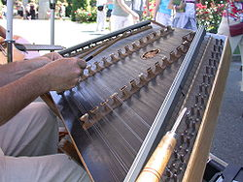
Who am I?
Rob Vatz
Email: rob.vatz@sceneralabs.com
Twitter @robvatz
Hobbies: Hammered Dulcimer, Aikido

Slide 3
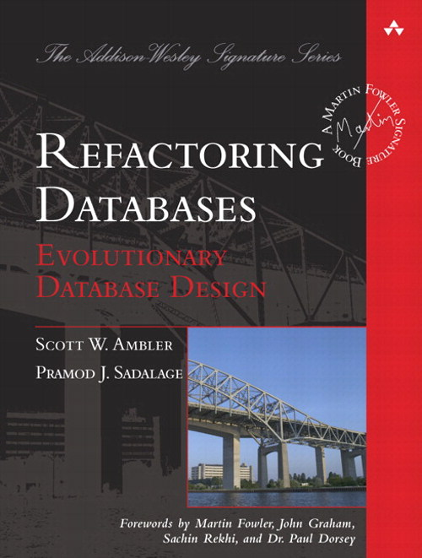
Refactoring Databases Book

Slide 4
Triggers: what and why
Triggers are stored procedures that run after or instead of DML or DDL.
Why? Refactoring databases, updatable views.
Why not? Hidden performance problems

Slide 5
Refactoring Database
Expand
Convert/copy data and add triggers
Migrate
Remove triggers
Contract

Slide 6
Expand
Add tables
Add columns
Add DEFAULT constraints
Remove UNIQUE, FOREIGN KEY, PRIMARY KEY constraints
Remove CHECK constraints

Slide 7
Migrate
Change stored procedures and functions to use new version
Developers change code to use new version

Slide 8
Contract
Remove tables
Remove columns
Remove stored procedures, functions
Remove DEFAULT constraints
Add UNIQUE, FOREIGN KEY, PRIMARY KEY constraints
Add CHECK constraints

Slide 9
Demo

Slide 10
Lessons Learned
SET RECURSIVE_TRIGGERS OFF/ON
Triggers execute even if table contents doesn’t change
Testing is painful, especially setup, so…
Have a test script

Slide 11
References
Evolutionary Database Design: http://martinfowler.com/articles/evodb.html
Expand/Contract pattern: http://martinfowler.com/bliki/ParallelChange.html
Refactoring Databases book
USPS Publication 28 - Postal Addressing Standards -- Section 2.1.1 http://pe.usps.gov/text/pub28/28c2_001.htm

Slide 12
Questions?

